Slide 1

Multi-Period Optimal Power Flow Aryan Ritwajeet Jha

Slide 2
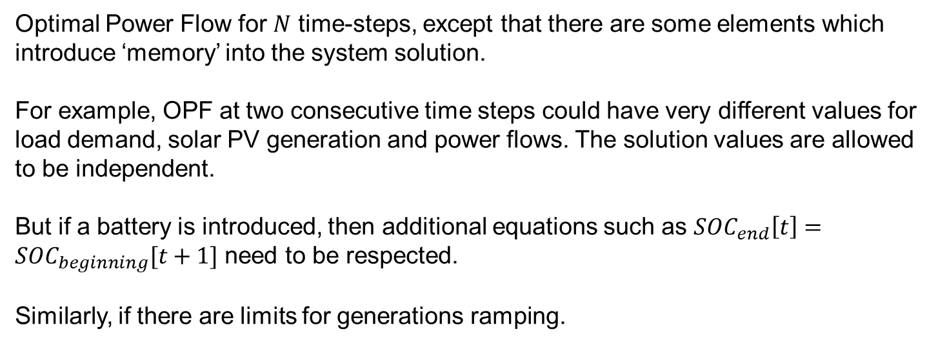
Multi-Period Optimal Power Flow
What?
Optimal Power Flow for $N$ time-steps, except that there are some elements which introduce ‘memory’ into the system solution.
For example, OPF at two consecutive time steps could have very different values for load demand, solar PV generation and power flows. The solution values are allowed to be independent.
But if a battery is introduced, then additional equations such as $SOC_{end}\left[t\right]=SOC_{beginning}[t+1]$ need to be respected.
Similarly, if there are limits for generations ramping.

Slide 3
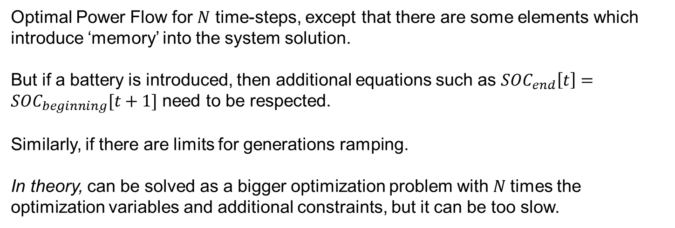
Multi-Period Optimal Power Flow
What?
Optimal Power Flow for $N$ time-steps, except that there are some elements which introduce ‘memory’ into the system solution.
But if a battery is introduced, then additional equations such as $SOC_{end}\left[t\right]=SOC_{beginning}[t+1]$ need to be respected.
Similarly, if there are limits for generations ramping.
In theory, can be solved as a bigger optimization problem with $N$times the optimization variables and additional constraints, but it can be too slow.

Slide 4
Multi-Period Optimal Power Flow
What?
In today’s presentation, I’ll show two approaches (in three papers) on how the authors attempt to solve this problem.

Slide 5
Large Scale Multi-Period Optimal Power Flow With Energy Storage Systems Using Differential Dynamic Programming
IEEE TRANSACTIONS IN POWER SYSTEMS (2022)
Aayushya Agarwal and Larry Pileggi
PhD student at Carnegie Mellon University (CMU)
Prof. at CMU
Reference papers with: Amritanshu Pandey Assistant Prof. at UVM

Slide 6

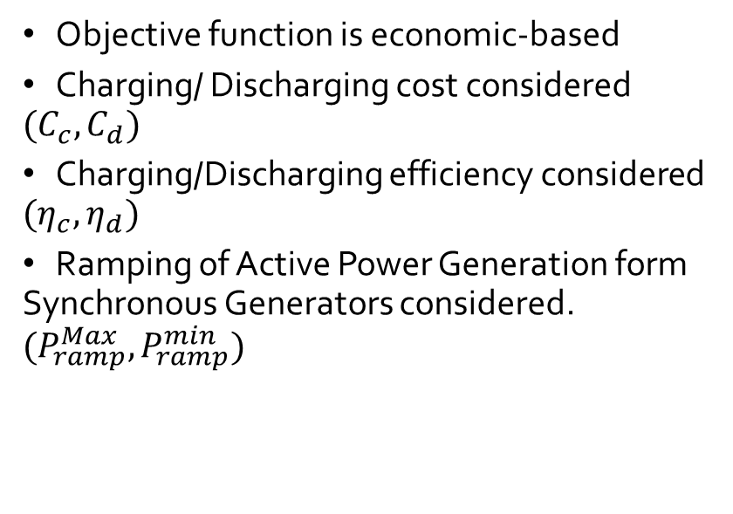
Large Scale Multi-Period Optimal Power Flow With Energy Storage Systems Using Differential Dynamic Programming
Objective function is economic-based
Charging/ Discharging cost considered $(C_{c}, C_{d})$
Charging/Discharging efficiency considered ${(η}_{c}, η_{d})$
Ramping of Active Power Generation form Synchronous Generators considered. $(P_{ramp}^{Max}, P_{ramp}^{min})$

Slide 7
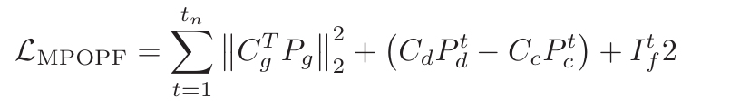
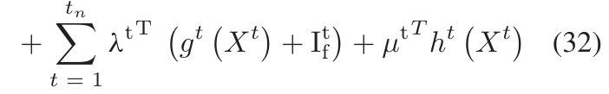

Large Scale Multi-Period Optimal Power Flow With Energy Storage Systems Using Differential Dynamic Programming
Optimization Problem Formulation: MP-OPF
If not for any Generator ramping or ESS constraints, the problem is just a summation of individual ACOPFs.
The authors anyway proceed to solve for each ACOPF individually but using a Forward-Backward Process.
While solving for time $t$, they assume any variables from $t+1$ as some constants and solve (‘forward-pass’) to get all variables for time-step $t+1$.
Then they do a ‘backwards-pass’ to update the sequence based on gradient information from the forward trajectory.
Together, a forward pass and a backward pass produce a new sequence of controls.
If converged, the backward pass does not affect the forward trajectory.

Slide 8
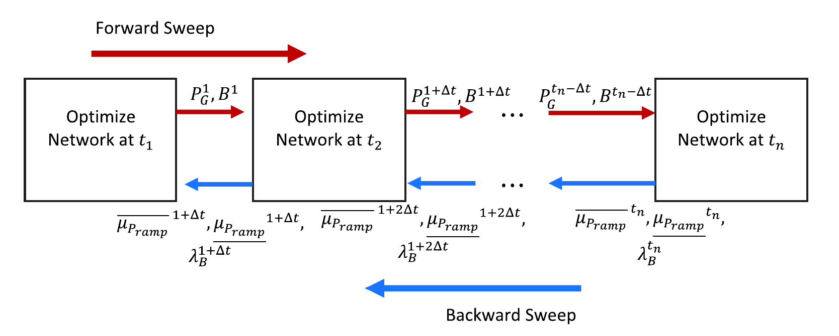
Large Scale Multi-Period Optimal Power Flow With Energy Storage Systems Using Differential Dynamic Programming
Optimization Problem Formulation: MP-OPF
Then they do a ‘backwards-pass’ to update the sequence based on gradient information from the forward trajectory.
Together, a forward pass and a backward pass produce a new sequence of controls.
If converged, the backward pass does not affect the forward trajectory.

Slide 9
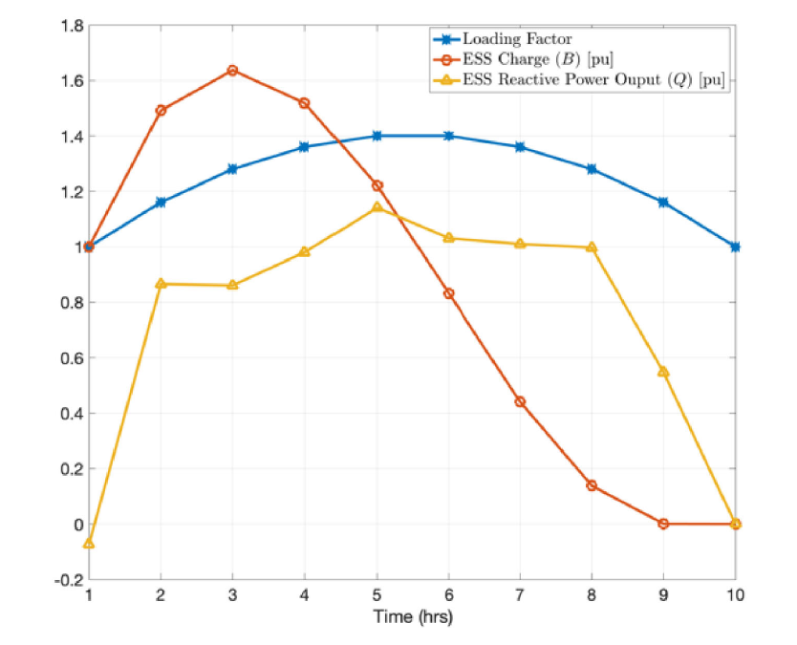
Large Scale Multi-Period Optimal Power Flow With Energy Storage Systems Using Differential Dynamic Programming
Results: 14 Bus System
Gen 02 replaced with an Energy Storage System.
Optimized over 10 hourly time-periods.
Loading factor is the blue curve (min. 1.0, Max. 1.4)
Optimal solution: Charge during periods of low demand (1 to 3), discharge during high loading time (hours 3 to 9). Because discharging cost is much lower than cost of getting power from synchronous machines.
Still, ramping constraints of the synchronous machines restrict the battery from discharging its entire energy.

Slide 10
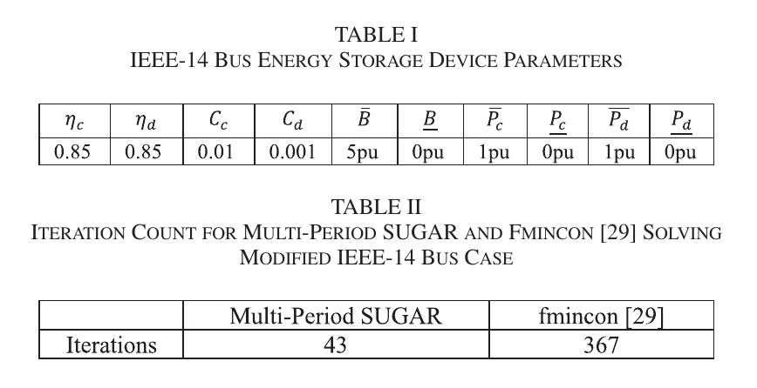
Large Scale Multi-Period Optimal Power Flow With Energy Storage Systems Using Differential Dynamic Programming
Results: 14 Bus System

Slide 11
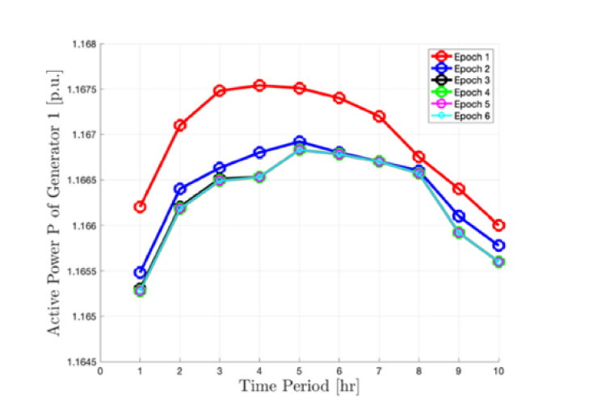
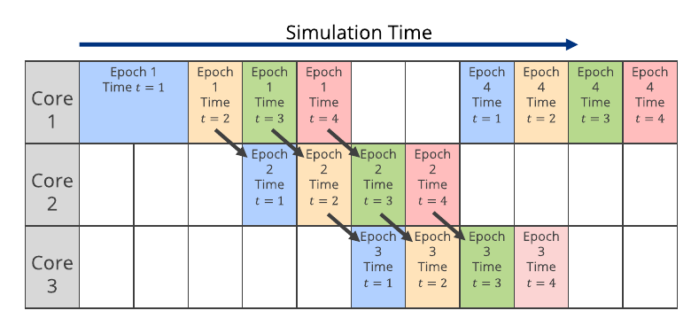
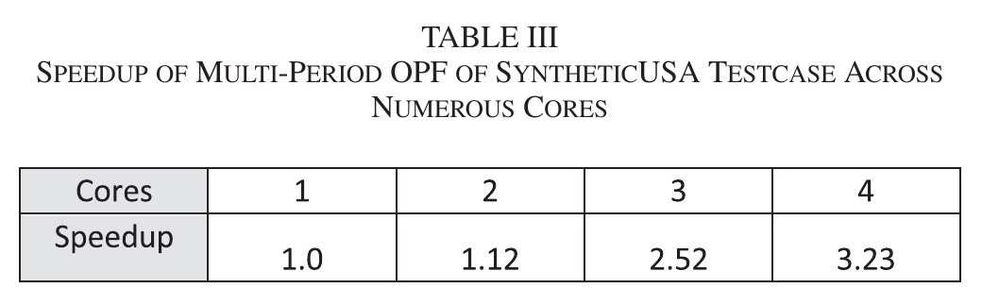
Large Scale Multi-Period Optimal Power Flow With Energy Storage Systems Using Differential Dynamic Programming
Results: Synthetic 70k testcase with parallelization

Slide 12
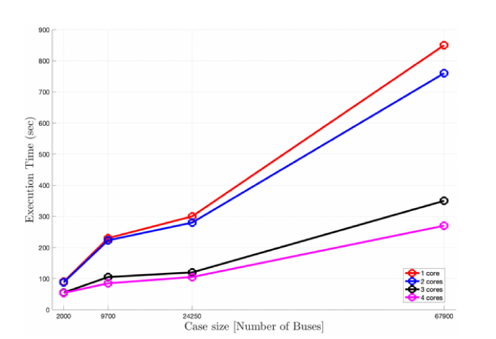
Large Scale Multi-Period Optimal Power Flow With Energy Storage Systems Using Differential Dynamic Programming
Results: Synthetic 70k testcase
Solving for 10 hours of 70k system data configuration took them 14 minutes on a single-core macbook.

Slide 13
Receding-Horizon Optimization of Unbalanced Distribution Systems with Time-Scale Separation for Discrete and Continuous Control Devices
Power System Computation Conference (2018)
Nawaf Nazir and Mads Almassalkhi
Currently at PNNL Then: PhD at University of Vermont (UVM)
Currently Assoc. Prof. at UVM

Slide 14
Receding-Horizon Optimization of Unbalanced Distribution Systems with Time-Scale Separation for Discrete and Continuous Control Devices
Distribution System
Unbalanced
Mechanical Assets?
Significant Solar Penetration
Two Different Optimization Time-Scales
A slow time-scale for dispatching discrete mechanical assets using Mixed-Integer Program (MIP)
A fast time-scale for continuously monitoring DERs using SOCP.

Slide 15
Receding-Horizon Optimization of Unbalanced Distribution Systems with Time-Scale Separation for Discrete and Continuous Control Devices
Two Different Optimization Time-Scales
Different Types of discrete and continuous operated devices.
E.g. Capacitor/Reactor Banks, Line Regulators (On/Off), Load-Tap-Changing (LTC) Transformers
Discrete states of these devices render the problem NP-hard.
This necessitates the use of separate optimization loops to coordinate them.
Mechanical assets also have operational constraints on tap changes per hour to limit wear and tear, which necessitates separation.

Slide 16
Receding-Horizon Optimization of Unbalanced Distribution Systems with Time-Scale Separation for Discrete and Continuous Control Devices
Flowchart showing the Hierarchical time-scale control algorithm
Forecast and Analytics
Hourly Dispatch of Mechanical Assets (MILP)
Minutely Dispatch of Flexible Assets (SOCP)
AC Three-phase Non-Linear Model (Plant)

Slide 17

Receding-Horizon Optimization of Unbalanced Distribution Systems with Time-Scale Separation for Discrete and Continuous Control Devices
Outer Loop Formulation: Voltage Positioning
Want to minimize number of changes in mechanical discrete control components to reduce wear and tear.
Aim: minimize $\left|ΔV\right|$ from a nominal set-point using operation of these discrete assets.
The outer loop also schedules active power exchanges of the STL elements, considering the variability of solar PV generation and forecast energy demands.
In order to reduce the computational complexity of the outer loop, a three-phase LINEARIZED model of the network is used.
This reduces the problem to a Mixed-Integer Linear Program (MILP).

Slide 18


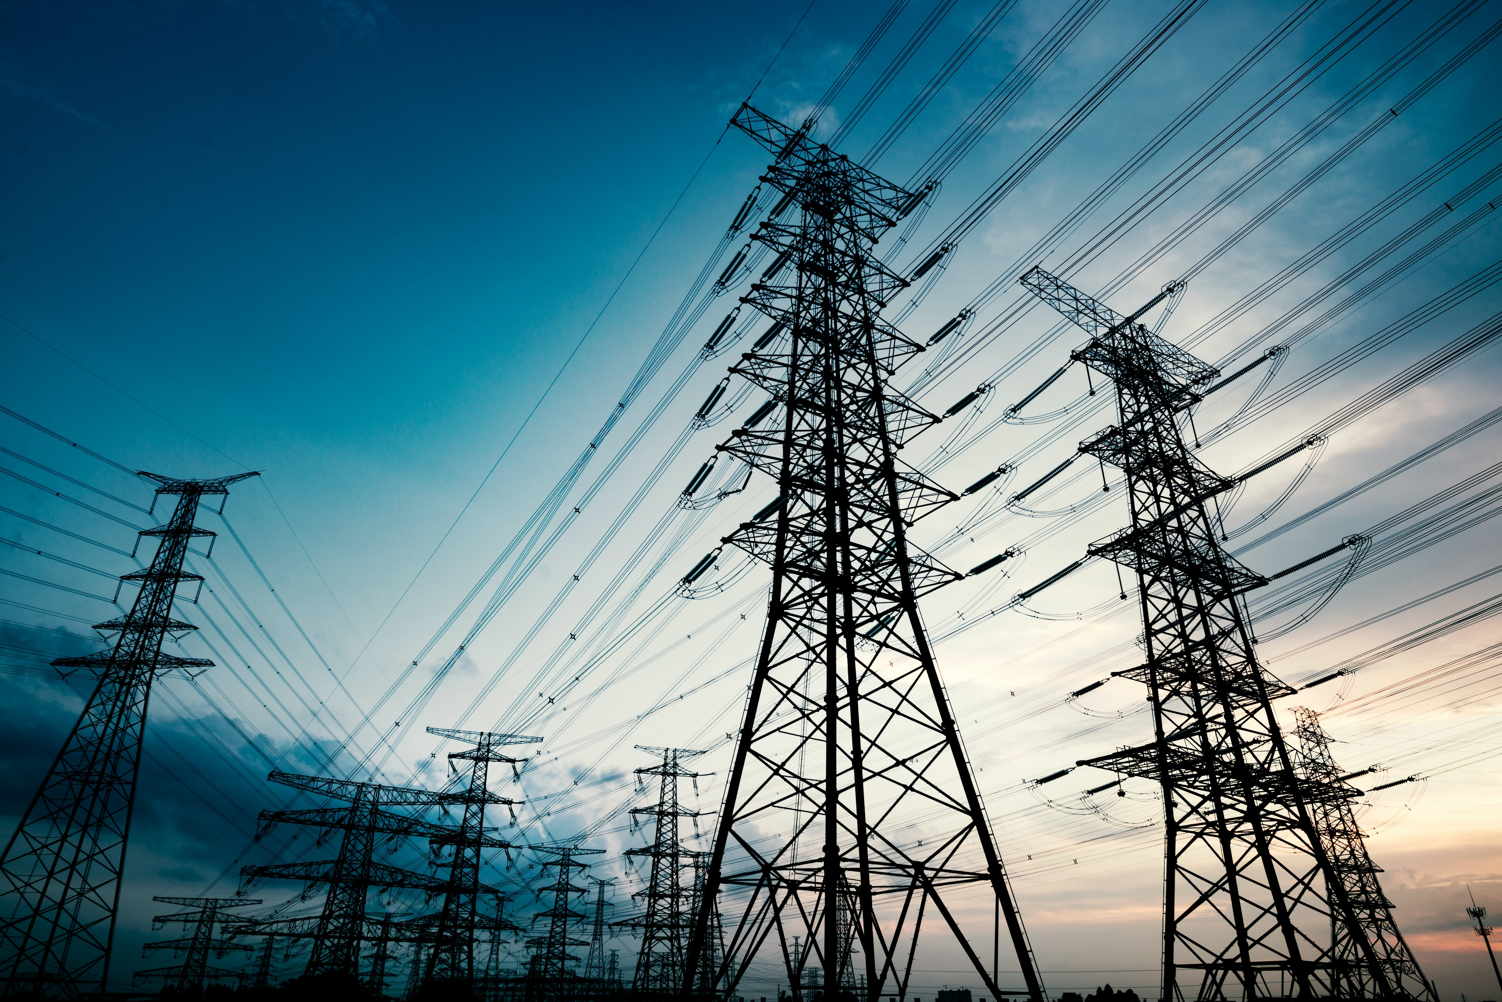


Receding-Horizon Optimization of Unbalanced Distribution Systems with Time-Scale Separation for Discrete and Continuous Control Devices
Outer Loop Formulation : Voltage Positioning
STL Architecture
Four-Quadrant Control Scheme. Can supply and consume both $P$ and $Q$.
Each STL element is composed of a renewable source of energy such as solar power and some form of storage like a battery bank.
Solar PV
Inverter
Transmission Network.
Battery
Inverter

Slide 19

Receding-Horizon Optimization of Unbalanced Distribution Systems with Time-Scale Separation for Discrete and Continuous Control Devices
Inner Loop Formulation: Corrective OPF
Aim: minimize $P_{Losses}$ in the network.
while keeping track of a power reference signal from the transmission level.
while keeping the system within operational bounds.
This program optimizes the STL elements over the fast time-scale.
This corrective optimization loop is required to be fast ($<1$ minute).
Three-phase SOCP used to solve the optimization problem.
A Branch Flow Model (BFM) is used to represent the power flow equations.

Slide 20
Optimal Multi-Period Dispatch of Distributed Energy Resources in Unbalanced Distribution Feeders
IEEE TRANSACTIONS IN POWER SYSTEMS (2020)
Nawaf Nazir, Pavan Racherla and Mads Almassalkhi
Currently at PNNL PhD at University of Vermont (UVM)
Currently Asst. Prof. at UVM
Currently Assoc. Prof. at UVM

Slide 21
Optimal Multi-Period Dispatch of Distributed Energy Resources in Unbalanced Distribution Feeders
Distribution System
Unbalanced
Inverter-Interfaced
Significant Solar Penetration
Three-Phase Unbalanced
Non-Convex Loss-minimization problem
Formulated as a Convex Second Order Conic Program (SOCP) for arriving at an initial solution for Non-Linear Program (NLP)
NLP run to ensure physically realizable solution

Slide 22
Optimal Multi-Period Dispatch of Distributed Energy Resources in Unbalanced Distribution Feeders
In [22] by the same authors, they have developed a three-phase convex SOCP relaxation of the multi-period OPF problem, and provided sufficient conditions which ensure the avoidance of simultaneous charging and discharging.
In this paper, they extend the work by developing a Multi-Period SOCP-NLP algorithm that provides a near optimal and guaranteed feasible solution.

Slide 23
Optimal Multi-Period Dispatch of Distributed Energy Resources in Unbalanced Distribution Feeders
The optimized solutions from the relaxed SOCP model, are used to initialize a Non-Linear Program (NLP) of the actual AC Power Flow, to obtain a physically realizable solution.
Real-Power Solutions that form the energy trajectory and are obtained from the SOCP, are fixed in the NLP, leading to a decoupling of the different time-steps.
As a result, the NLP solves for each time-step separately (possibly in-parallel), leading to a scalable framework.
Validation is performed using GridLab-D.

Slide 24
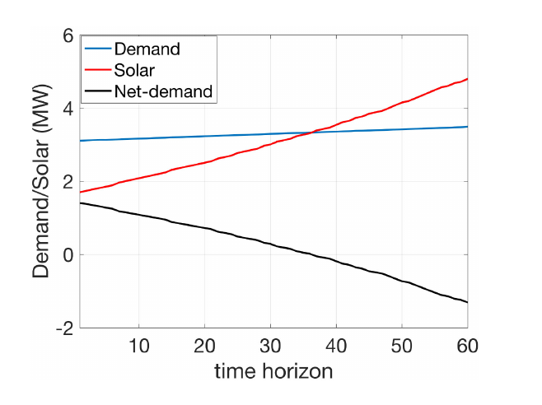


Optimal Multi-Period Dispatch of Distributed Energy Resources in Unbalanced Distribution Feeders
Case Study Description
IEEE $123$, Unbalanced, $kV_{B}=2.4, MVA_{B}=1$
Algorithm implemented in Receding-Horizon fashion.
Receding-Horizon means a rolling window where predictions for the next $T$ time-steps from time $t+1$to $t+T$are made at time $t,$and since predictions are updated at every time step, for the next time step $t+1$ , predictions for the next $T$ time steps from $t+2$to $t+T+1$ are once again made.
The cycle goes on.
Fig. Aggregate solar, demand and net-demand profile over a prediction horizon of $60 minutes.$

Slide 25
Optimal Multi-Period Dispatch of Distributed Energy Resources in Unbalanced Distribution Feeders
The SOCP solution outputs an optimal battery and inverter control schedule
The schedule is used by the NLP to calculate a physically realizable schedule
The physically realizable schedule is implemented by GridLab-D to determine the resulting AC Power Flows.
The forecast of demand and renewable generations are updated.
The Process

Slide 26
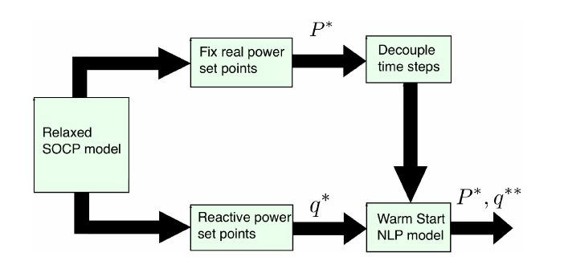
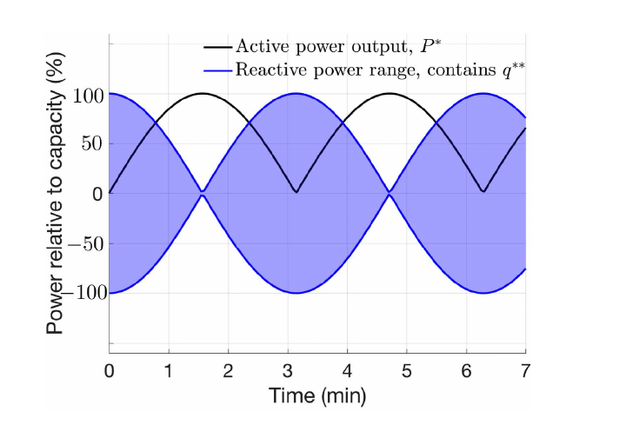
Optimal Multi-Period Dispatch of Distributed Energy Resources in Unbalanced Distribution Feeders
The Process
Fig. Coupling of SOCP with NLP by fixing real power solutions from SOCP and hence decoupling the NLP to obtain a feasible solution. (What? How?)
Fig. Available reactive power variation range for NLP across multiple time-steps based on the active power trajectory provided by the SOCP.

Slide 27

Optimal Multi-Period Dispatch of Distributed Energy Resources in Unbalanced Distribution Feeders
Case Study Description
Distributed Storage and Solar PV Units randomly added to $16$ nodes
They can supply active and reactive power through four quadrant operation.
Each storage unit has capacity $=40kWh$ and apparent power rating $=50kVA$
Each solar PV unit has a rating $=100kVA$
Solar and Load Profile prediction horizon $30 steps=30 min.$
Each step $=1 min.$

Slide 28

Optimal Multi-Period Dispatch of Distributed Energy Resources in Unbalanced Distribution Feeders
Case Study Description
Three-phase OPF is run in a receding horizon fashion with prediction horizon of $30$ time-steps, for the dispatch of controllable assets of the network to minimize network losses.
Set-points provided by the solutions of the SOCP are used to initialize an NLP to provide a feasible solution.
SOCP modeled in JuMP, with Julia and solved using GUROBI.
Multi-period SOCP has
$108$k variables (k as in thousand)
$48$k linear constraints
$81$k SOC constraints

Slide 29
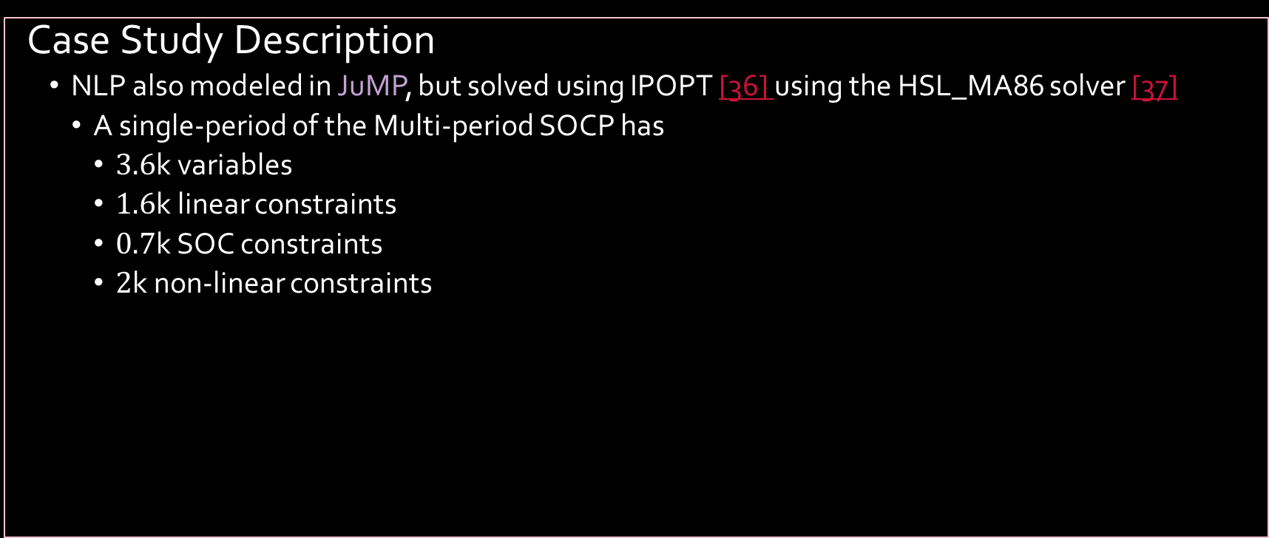
Optimal Multi-Period Dispatch of Distributed Energy Resources in Unbalanced Distribution Feeders
Case Study Description
NLP also modeled in JuMP, but solved using IPOPT [36] using the HSL_MA86 solver [37]
A single-period of the Multi-period SOCP has
$3.6$k variables
$1.6$k linear constraints
$0.7$k SOC constraints
$2$k non-linear constraints

Slide 30
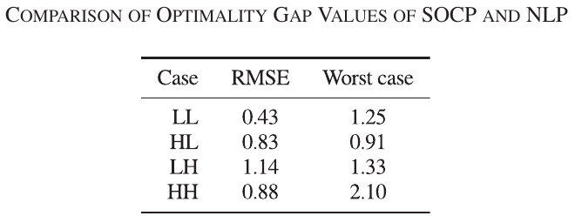
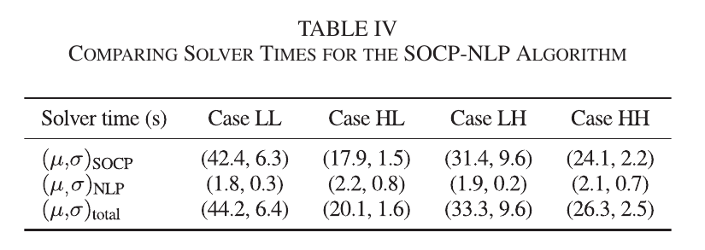

Optimal Multi-Period Dispatch of Distributed Energy Resources in Unbalanced Distribution Feeders
Results
Optimality gap always below 3% for different solar penetration levels.
Feasible solutions always ($<1e−5pu$ difference).
Solution times $<45s$
NLP total time assuming parallelized operation over every single time step.
Table: Comparison of the Optimality Gap Values of SOCP and NLP.

Slide 31
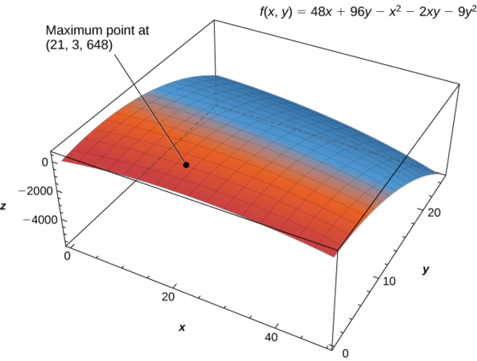
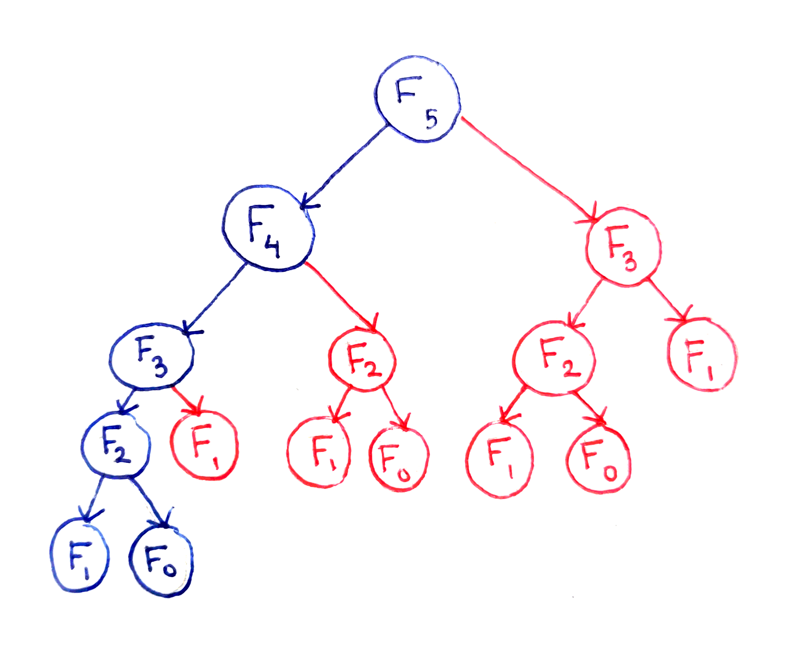
In summary, the Multi-Period Optimal Power Flow problem can be solved using multiple approaches.
Optimization
Dynamic Programming
And other approaches.
Questions?

Slide 32
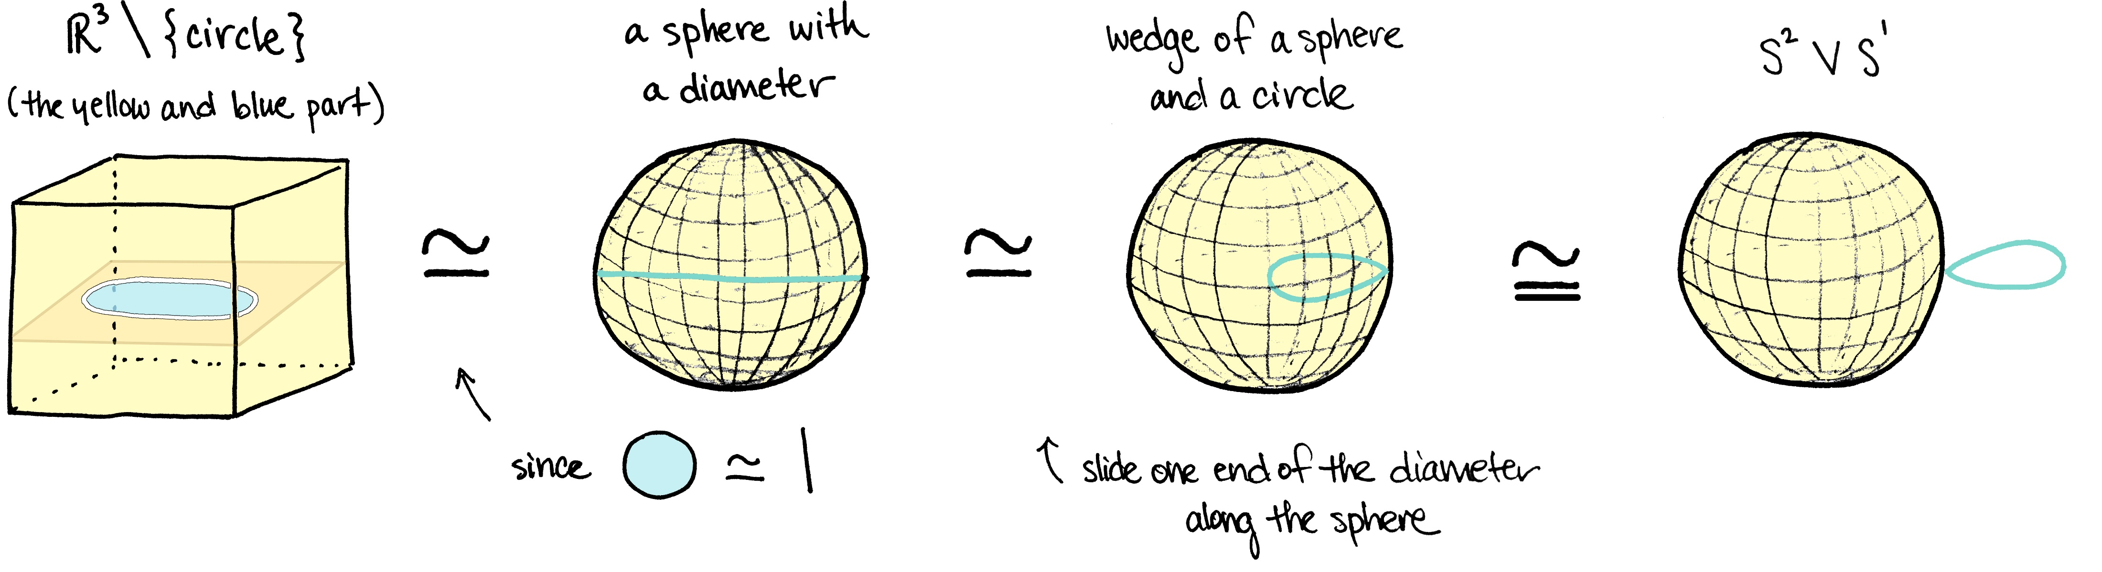
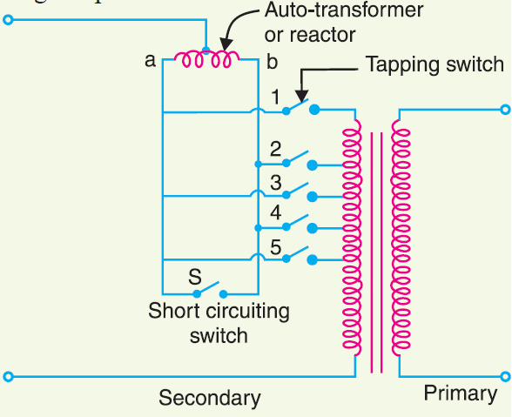
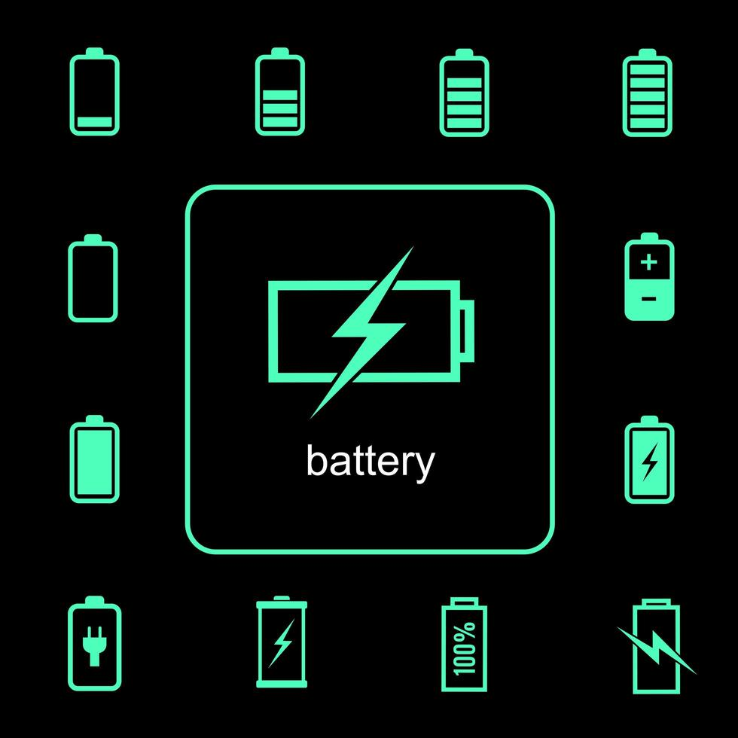
But it is the encompassing problem statement, including assumptions used and contingencies neglected which make every proposed Multi-Period Optimal Power Flow solution unique.
Homotopy
Other binary/nominal-discrete-valued elements in the system
Factoring the possibility of Simultaneous Charging/Discharging
And other constraints/contingencies.
Questions?

Slide 33

[22] Nazir, N., & Almassalkhi, M. (2018). Receding-Horizon Optimization of Unbalanced Distribution Systems with Time-Scale Separation for Discrete and Continuous Control Devices. 2018 Power Systems Computation Conference (PSCC). IEEE. doi: 10.23919/PSCC.2018.8442555 [36] Wächter, A., & Biegler, L. T. (2006). On the implementation of an interior-point filter line-search algorithm for large-scale nonlinear programming. Math. Program., 106(1), 25–57. doi: 10.1007/s10107-004-0559-y [37] HSL - Home Page. (2023, May 24). Retrieved from https://www.hsl.rl.ac.uk [16b] Briglia, E., Alaggia, S., & Paganini, F. (2017). Distribution network management based on optimal power flow: Integration of discrete decision variables. 2017 51st Annual Conference on Information Sciences and Systems (CISS). IEEE. doi: 10.1109/CISS.2017.7926079
References

Slide 34
[20b] Pandey, A., Agarwal, A., & Pileggi, L. (2020). Incremental Model Building Homotopy Approach for Solving Exact AC-Constrained Optimal Power Flow. arXiv, 2011.00587. Retrieved from https://arxiv.org/abs/2011.00587v1 [23b] Pillage, L. (1998). Electronic Circuit & System Simulation Methods (SRE). McGraw-Hill Professional. Retrieved from https://www.amazon.com/Electronic-Circuit-System-Simulation-Methods/dp/0070501696
References

